Slide 1
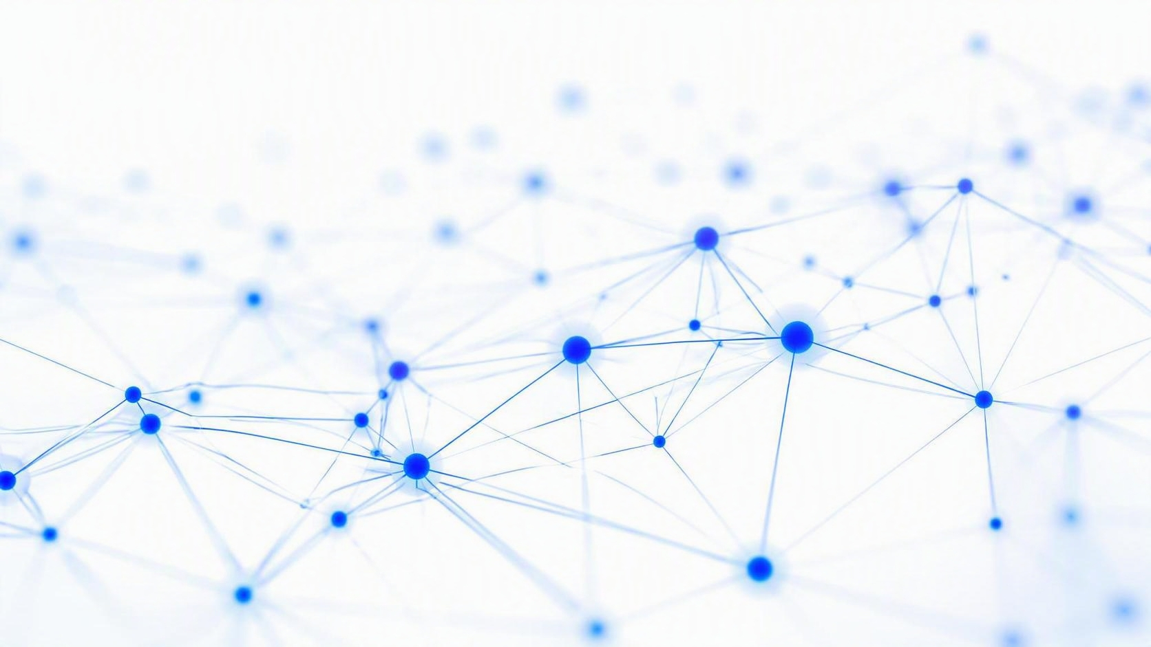
Predicting Customer Churn to Improve
Retention and Business Performance
CHURN PREDICTION · CUSTOMER ANALYTICS · RETAIL
Predicting and reducing customer churn with historical transaction data
Lisa A Phillips, MBA, MHP, HIA · July 6, 2026

Slide 2
The story in brief
EXECUTIVE SUMMARY
RECOMMENDED MODEL
Logistic Regression
Every missed churner is lost revenue — best recall (0.67) catches the most.
2,130
65% / 35%
4
customers modeled
retained vs. churned
models compared
KEY TAKEAWAYS
Catching customers before they leave matters more than raw accuracy — the recommended model flags nearly three times as many at-risk customers as the higher-accuracy alternatives.
Random Forest and XGBoost scored higher accuracy (56%) but low recall, missing most at-risk churners.
Purchase frequency, recency, and spend are the strongest signals of customer churn.
Recommended next step: launch targeted retention for the customers most likely to leave.
Using ML to Improve Customer Purchasing Decisions
02

Slide 3
What we set out to solve
BUSINESS PROBLEM
OBJECTIVE
BUSINESS VALUE
Develop a machine learning solution that predicts which customers are most likely to churn so the retailer can proactively improve customer retention and maximize long-term revenue.
Increase customer lifetime value
Retain loyal customers to grow long-term value.
BUSINESS GOALS
Reduce customer attrition
Improve customer retention
Identify customers at risk of churning
Better understand purchasing behavior
Support data-driven marketing and inventory decisions
Engage proactively to reduce customer attrition.
Improve marketing ROI
Target customers most likely to respond.
Enable informed decisions
Use predictive analytics to guide business choices.
Using ML to Improve Customer Purchasing Decisions
03

Slide 4
Three related datasets
DATA SOURCES
EXPLORATORY DATA
RETAIL TRANSACTION DATA
CUSTOMER MODELING DATA
45,209
15,206
2,130
customer records
online purchases
customers
Demographics
Invoice history
Purchase frequency
Transactions
Product descriptions
Recency
Marketing variables
Purchase quantities
Tenure
Device usage
Total spending
Monetary value
Churn status
Using ML to Improve Customer Purchasing Decisions
04

Slide 5
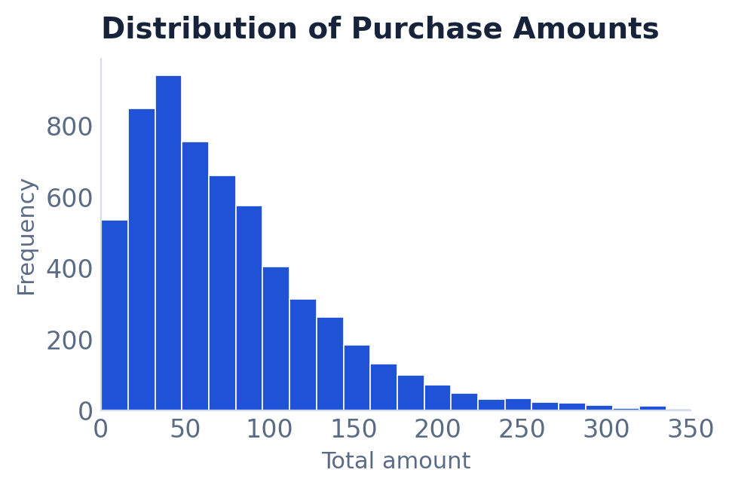
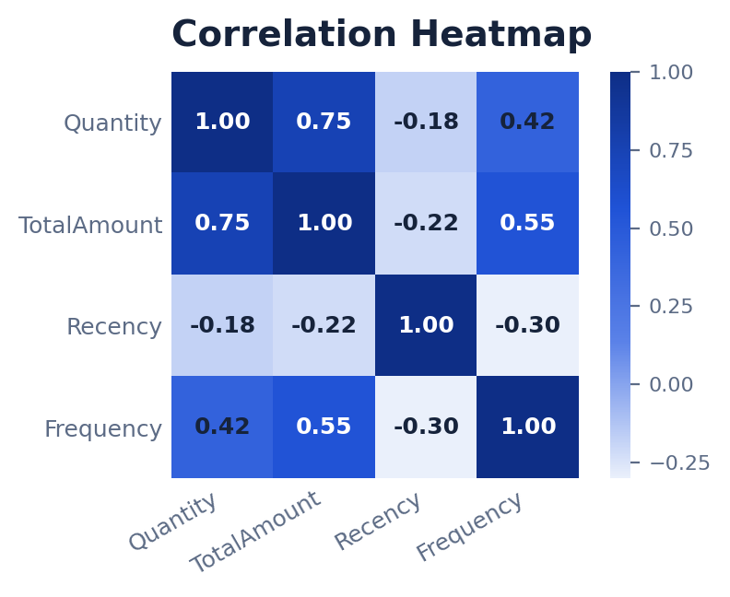
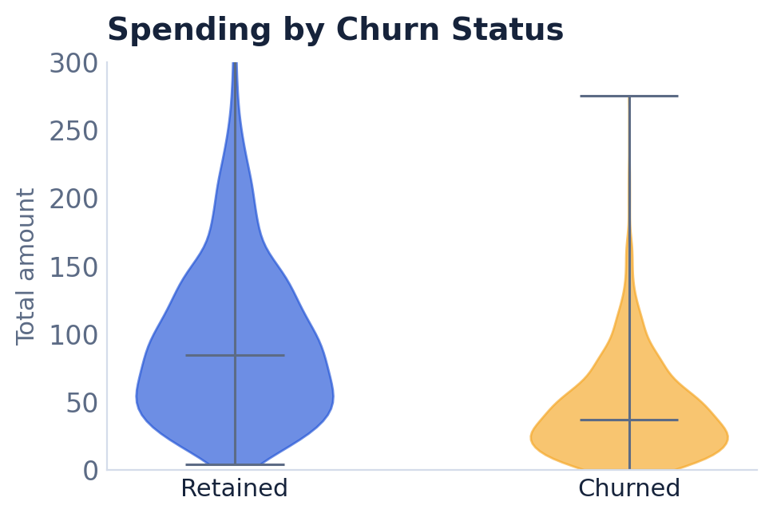
Understanding the data
EXPLORATORY DATA ANALYSIS
All transactions occurred within the United Kingdom.
Purchase amounts were highly right skewed — many low value purchases and relatively few high value transactions.
Several numeric variables required transformation before modeling.
Quantity and Total Amount were strongly correlated (0.75) — more items purchased generally meant higher sales revenue.
Average product prices varied considerably across product categories, highlighting pricing and merchandising opportunities.
Skewed purchase amounts
Correlation of key features
Average Product Price by Item Category
Illustrative EDA visuals.
Using ML to Improve Customer Purchasing Decisions
05

Slide 6
Getting the data model-ready
DATA PREPARATION
PREPARATION STEPS
CLASSIFICATION DATASET
1
Removed missing values
2,130 customers
2
Standardized variables
3
Engineered new features
4
Split train / test (80 / 20)
1,380 retained (65%)
Target variable: Customer Churn
750 churned (35%)
5
Using ML to Improve Customer Purchasing Decisions
06

Slide 7
Four models, compared head-to-head
MACHINE LEARNING MODELS
01
02
03
04
Dummy Classifier
Logistic Regression
Random Forest
XGBoost
Baseline for comparison
Interpretable linear model
Ensemble of decision trees
Gradient-boosted trees
“To identify the model that best predicts customer churn while balancing accuracy and interpretability.”
Using ML to Improve Customer Purchasing Decisions
07

Slide 8
How the models were built and judged
METHODOLOGY
RECOMMENDED MODEL
Logistic Regression
Every missed churner is lost revenue — best recall (0.67) catches the most.
MODELING APPROACH
EVALUATION METRICS
1
Clean and prepare the data
Accuracy — Share of predictions that were correct.
2
Engineer predictive features
Precision — How many flagged churners truly churned.
Split into train / test (80 / 20)
Recall — How many actual churners were caught.
3
F1-score — Balance of precision and recall.
4
Train the four candidate models
ROC-AUC — Ability to separate churn from retention.
5
Evaluate and select the best
Recall is weighted heavily — catching churners matters more than raw accuracy.
Using ML to Improve Customer Purchasing Decisions
08

Slide 9
Model performance comparison
RESULTS
RECOMMENDED MODEL
Logistic Regression
Every missed churner is lost revenue — best recall (0.67) catches the most.
MODEL
ACCURACY
F1 SCORE
PRECISION
RECALL
ROC-AUC
Dummy Classifier
48.6%
0.2526
0.2534
0.2517
0.4305
Logistic Regression
43.4%
0.4510
0.3390
0.6735
0.4909
Random Forest
55.6%
0.2286
0.2857
0.1905
0.4698
XGBoost
56.6%
0.2688
0.3208
0.2313
0.4866
Because the primary business objective is customer retention, recall was prioritized over overall accuracy when evaluating model performance. Although Logistic Regression produced the lowest overall accuracy, it achieved the highest recall, successfully identifying the greatest number of customers at risk of churning. This makes it the most appropriate model for supporting proactive customer retention strategies.
Final model results from the classification notebook; recall is weighted most heavily per the methodology.
Using ML to Improve Customer Purchasing Decisions
09

Slide 10
What drives churn
BUSINESS INSIGHTS
01
Frequent Customers Are More Loyal
02
Low Spending Indicates Higher Risk
Customers who purchase more frequently are significantly less likely to churn, making purchase frequency one of the strongest indicators of customer loyalty.
Customers with infrequent purchases and lower overall spending are more likely to discontinue purchasing and should be prioritized for retention efforts.
03
Recent Activity Predicts Future Engagement
04
Customer Segmentation Improves Marketing
Customers who have purchased recently are more likely to remain active, while extended periods without purchases often indicate an increased risk of churn.
Segmenting customers based on purchasing behavior enables more personalized marketing campaigns, increasing customer engagement while improving marketing efficiency.
Using ML to Improve Customer Purchasing Decisions
10

Slide 11
How we built the segments
CUSTOMER SEGMENTATION
01
Scale the Features
02
Choose the Cluster Count
Standardized five behavioral features—frequency, recency, tenure, monetary value, and unique items—across 2,130 customers so no single metric dominated the distance calculation.
Compared elbow-method inertia with silhouette scores from two to ten clusters, landing on five as the best balance of separation and interpretability.
03
Fit the K-Means Model
04
Validate with PCA
Trained a K-means model with five clusters on the scaled data, assigning every customer to the segment its profile most closely matched.
Reduced the features to two dimensions with principal component analysis to confirm the five segments were visually distinct and cohesive.
Using ML to Improve Customer Purchasing Decisions
11

Slide 12
Five distinct customer segments
SEGMENTATION RESULTS
0
Low-Value Newcomers
1
Micro Outlier Group
2
Mid-Sized Cluster
671 customers with short tenure and minimal spend, recently acquired and still low-commitment.
Just 10 customers forming a small, highly distinct niche set apart from every other segment.
246 customers grouped into a moderate segment with its own shared purchasing pattern.
3
Dormant Long-Tenured
4
High-Value Actives
546 long-standing customers who have gone quiet, showing very low recent spending.
657 frequent, high-spending customers, the most engaged and most valuable group.
Using ML to Improve Customer Purchasing Decisions
12

Slide 13
Signature segments in depth
SEGMENT PROFILES
LOW-VALUE NEWCOMERS
DORMANT LONG-TENURED
HIGH-VALUE ACTIVES
671
546
657
customers · segment 0
customers · segment 3
customers · segment 4
Avg. spend $2.84
Avg. spend $1.47
Avg. spend $23.60
Frequency 0.26
Frequency 0.15
Frequency 2.15
Recency 10
Recency 9
Recency 192
Tenure 73 days
Tenure 266 days
Tenure 274 days
2.4 unique items
Using ML to Improve Customer Purchasing Decisions
13

Slide 14
CLUSTERING VALIDATION
How many segments? Silhouette scores
Reading the curve
The score is highest at two clusters (0.44), then settles near 0.37 as more clusters are added. Raw score alone favors the coarsest split.
We chose five (highlighted) — where the curve levels off and the segments stay distinct yet detailed enough to act on.
k = 5 selected
Balances separation with interpretability
Silhouette scores from the K-means clustering notebook (scikit-learn), k = 2 to 10.
Using ML to Improve Customer Purchasing Decisions
14

Slide 15
CLUSTER VISUALIZATION
Five segments, seen in two dimensions
What PCA shows
Principal component analysis compresses the five behavioral features into two axes, letting us see the segments on a single plane.
The High-Value Actives spread to one side, the Dormant and Newcomer groups cluster near the center, and the 10-customer Micro Outlier group sits far apart — confirming the five segments are genuinely distinct.
Illustrative PCA projection — a schematic view of the five K-means segments, not exact point coordinates.
Using ML to Improve Customer Purchasing Decisions
15

Slide 16
SEGMENT PLAYBOOK
From segments to marketing action
0
Low-Value Newcomers
671 customers
WELCOME & ONBOARD
Nurture with a first-purchase series and starter offers to build early buying habits.
1
Micro Outlier Group
10 customers
INVESTIGATE MANUALLY
Review this tiny niche by hand for data quirks or a bespoke, high-touch approach.
2
Mid-Sized Cluster
246 customers
TEST & LEARN
Run targeted campaigns to learn what moves this middle group and lift their value.
3
Dormant Long-Tenured
546 customers
WIN BACK
Re-engage with reactivation offers and reminders before these long-tenured buyers churn.
4
High-Value Actives
657 customers
REWARD & RETAIN
Prioritize loyalty perks and VIP treatment to protect the most valuable segment.
NEXT These segment plays feed directly into the retention recommendations ahead.
Using ML to Improve Customer Purchasing Decisions
16

Slide 17
How we built the model
METHODOLOGY
01
Prepare & Split the Data
02
Train Candidate Models
The dataset covers 2,130 customers with five behavioral features. An 80/20 stratified split yields 1,704 training and 426 test records.
Four regressors target the churn label: a Dummy Regressor baseline alongside Linear Regression, Random Forest, and XGBoost.
03
Standardize & Evaluate
04
Compare Against Baseline
Features are standardized before scoring. Each model is measured on the held-out test set using R², mean absolute error, and mean squared error.
Models are ranked by error to test whether any regressor can beat the naive baseline that simply predicts the average churn rate.
Predicting Customer Churn with Regression Models
17

Slide 18
Regression model comparison
RESULTS
LOWEST ERROR
Dummy Baseline
No regressor beat the naive baseline; its 0.23 MSE was the lowest of all.
MODEL
R² SCORE
MAE
MSE
Dummy Regressor
0.0000
0.4563
0.2281
Random Forest
-0.2920
0.4724
0.2947
XGBoost
-0.3239
0.4739
0.3020
Linear Regression
-53.2399
2.9211
12.3737
Sorted by mean squared error, no regression model beat the naive Dummy baseline. Every trained regressor posted a negative R², and Linear Regression collapsed entirely on the binary target — confirming that churn is a classification problem, not a regression one.
Regression metrics on the held-out test set, sorted by mean squared error (lower is better).
Predicting Customer Churn with Regression Models
18

Slide 19
Why regression fell short
THE TAKEAWAY
BASELINE TO BEAT
THE CHALLENGERS
THE VERDICT
0.2281
0 of 3
≤ 0
dummy baseline MSE
beat the baseline
R² for every model
Predicts the average churn rate
Linear Regression: R² -53.24
Churn is binary, not continuous
R² of exactly 0.0000
Random Forest: MSE 0.2947
Regression is the wrong tool
Lowest error of any model
XGBoost: MSE 0.3020
Classification fits the target
The bar every model must clear
All posted a negative R²
A classifier catches at-risk buyers
Reframe as churn classification
Predicting Customer Churn with Regression Models
19

Slide 20
ESTIMATED BUSINESS IMPACT
What better retention could be worth
~5 pts
~100
3×
targeted churn reduction
customers retained per year
more churners caught early
HOW THE MODEL PAYS OFF
Recall-first targeting flags nearly three times as many at-risk customers, so far fewer slip away unnoticed.
Trimming annual churn by about five percentage points across 2,130 customers keeps roughly 100 relationships alive.
Every customer kept preserves future spend and avoids the higher cost of acquiring a replacement.
Illustrative estimate — hypothetical figures based on the modeled customer base, not booked financial results.
Using ML to Improve Customer Purchasing Decisions
20

Slide 21
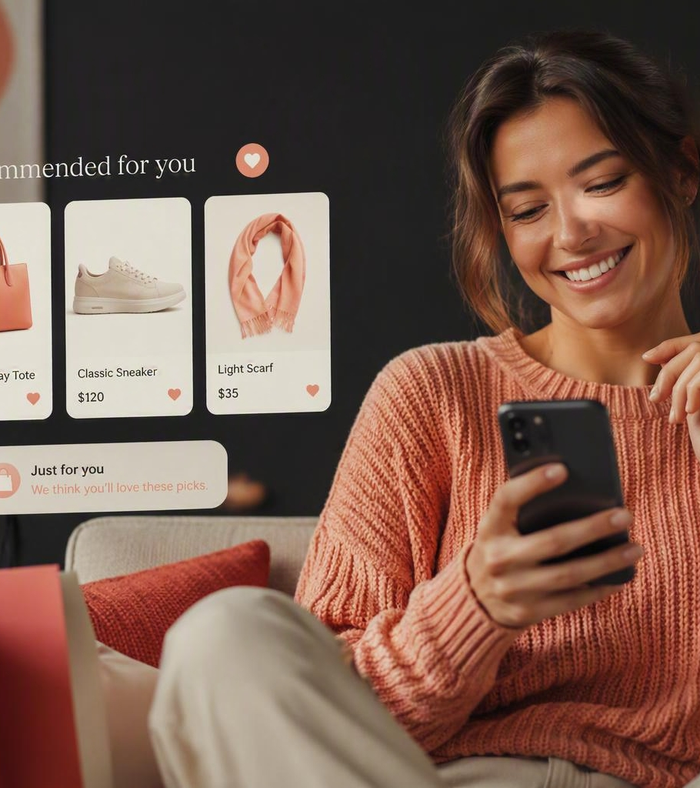
What the retailer should do
RECOMMENDATIONS
RECOMMENDED MODEL
Logistic Regression
Every missed churner is lost revenue — best recall (0.67) catches the most.
Recall-first: catching at-risk customers matters more than raw accuracy.
Trigger win-back offers to Dormant and at-risk customers within 30 days of a churn flag.
✔
Personalize promotions by segment, using recency, frequency, and spend to tailor each offer.
✔
Expand loyalty and rewards for High-Value Actives to protect the revenue base.
✔
Score churn predictions weekly and route flagged customers into retention automatically.
✔
Retrain the model quarterly on fresh data to keep recall high as behavior shifts.
✔
Using ML to Improve Customer Purchasing Decisions
21

Slide 22
Expected benefits
BUSINESS IMPACT
1
Increase Revenue
2
Reduce Customer Churn
3
Improve Customer Engagement
Improve repeat purchases through proactive customer retention.
Identify at-risk customers before they leave.
Deliver personalized offers that encourage continued purchasing.
4
Optimize Marketing Investments
5
Improve Inventory Planning
6
Support Data-Driven Decision Making
Focus marketing resources on customers with the greatest retention potential.
Better anticipate future purchasing demand through predictive analytics.
Provide leadership with actionable insights that improve strategic planning.
Using ML to Improve Customer Purchasing Decisions
22

Slide 23
Where this can go next
FUTURE ENHANCEMENTS
01
Add customer demographics
Incorporate customer demographic information to improve predictive accuracy.
02
Integrate engagement data
Integrate website browsing and customer engagement data.
03
Enable real-time predictions
Deploy the model to generate real-time churn predictions.
04
Explore advanced ML
Evaluate advanced machine learning techniques, including deep learning.
05
Build a leadership dashboard
Build an interactive business dashboard for leadership.
06
Schedule model retraining
Establish a scheduled retraining process so performance holds as customer behavior evolves.
Using ML to Improve Customer Purchasing Decisions
23

Slide 24
ANTICIPATED QUESTIONS
Questions we anticipate
Why wasn’t the model with the highest accuracy selected?
How often should the model be retrained?
Because retaining customers is the primary business objective. Recall was prioritized to identify as many at-risk customers as possible, even if overall accuracy was lower.
The model should be retrained quarterly or whenever significant changes in customer purchasing behavior are observed.
How can this model support business decisions?
What additional data could improve performance?
Customer demographics
Website browsing behavior
Email campaign engagement
Loyalty program participation
Customer service interactions
The predictions can help marketing teams prioritize retention campaigns, personalize promotions, improve customer engagement, and allocate resources more effectively.
Using ML to Improve Customer Purchasing Decisions
24

Slide 25
THANK YOU
Don’t just predict churn — prevent it.
Every at-risk customer we catch early is revenue kept, not lost.
Thank you — I welcome your questions and feedback.

